Slide 1

UT CARE™ Medicare PPO for The University of Texas System Retirees
Blue Cross and Blue Shield of Texas, a Division of Health Care Service Corporation,
a Mutual Legal Reserve Company, an Independent Licensee of the Blue Cross and Blue Shield Association
Y0096_GRPUTSPPT23_M

Slide 2
Coming January 1, 2023
The new UT CARE™ Medicare PPO plan replaces UT SELECT for Medicare-eligible retirees in January, and it comes with many advantages.
Robust Provider Network
Dedicated Care Management Professionals
Prevention and Wellness Support
  Medicare-Specialized Customer Service Team

Slide 3

Today’s Topics
Medicare Basics
UT CARE™ Overview
Supplemental Benefits Overview
Enrollment Kit Review
Next Steps and Reminders
Ongoing Communication

Slide 4
UT CARETM Medicare PPO Basics

Slide 5

P A R T
A
A
Part A
Hospital Insurance/
Original Medicare
HELPS COVER
Inpatient care in hospitals
Skilled nursing facility care
Hospice care
Home health care
While most Americans are enrolled automatically in Medicare Part A, it alone may not cover all health care costs. Parts B, C, and D are voluntary programs that provide additional coverage.
The ABCs of Medicare
PART

Slide 6
Part B
Medical Insurance/ Original Medicare
PART
HELPS COVER
Services from doctors and other
health care providers
Outpatient care
Durable medical equipment (such as wheelchairs, walkers, hospital beds, and
other equipment and supplies)
Many preventive services (such as screenings,
shots, and yearly wellness visits)
B
The ABCs of Medicare
If you don’t enroll in Part B when you are first eligible for Medicare, you may have to pay a penalty later. You must have Part B to be eligible for the UT CARE™ plan.

Slide 7
Part C
Medicare Advantage Plan
The UT CARE™ Medicare PPO plan is also called Medicare Part C or MA.
Part C is an alternative to Original Medicare (Parts A+B).
A Medicare Advantage Plan provides all the benefits of Original Medicare, plus some benefits that Medicare does not provide.
PART
The ABCs of Medicare
C

Slide 8
Part D
Prescription Drug Coverage
UT CARE™ members will continue to be enrolled in the UT Medicare Part D prescription drug plan.
The Part D drug plan will be renamed the UT CARE™ Part D prescription drug plan.
New ID cards will be issued prior to January 1, 2023.
PART
The ABCs of Medicare
D

Slide 9
Overview of
UT CARE™ Medicare PPO

Slide 10
UT CARE™ Medicare PPO Plan Highlights
Medical Coverage
Annual Deductible | $0
Out-of-Pocket Maximum | $0
Inpatient Hospital Services | $0
Outpatient Hospital Services | $0
Emergency/Urgency Care | $0
Primary Care Office Visit | $0
Specialist Care Office Visit | $0
Physical, Speech & Occupational Services | $0
Ambulance Services | $0

Slide 11
National Open Access Provider Network
UT CARE™ Medicare PPO oﬀers members access to care from any provider nationwide who accepts Medicare assignment and who will submit claims to Blue Cross and Blue Shield of Texas.
98% of U.S. physicians accept Medicare assignment, according to the U.S. Centers for Medicare & Medicaid Services (CMS¹).
Members’ coverage levels are the same in and out of network.
Referrals are not required for specialist visits.
1. CMS Dec. 2021

Slide 12
UT CARE™ Medicare PPO
Extra Health and Wellness Benefits

Slide 13

Extra Health and Wellness Benefits
Included in your plan, you will have access to extra health and wellness benefits:
    MDLIVE® Virtual Visits
    24/7 Nurseline
    Blue365®
    TruHearing®
    SilverSneakers®
    Fitness Program
    Private Duty Nursing
    Hinge Health
    Livongo®
    Omada®
    Learn to Live
    Airrosti®
    Wondr Health™
    Catapult Health

Slide 14

Virtual Visits
What are Virtual Visits?
Virtual Visits, powered by MDLIVE®, allow plan members to access care for non-emergency situations by phone, mobile app or online video anytime, anywhere.
Speak to a doctor, a behavioral health specialist, or schedule
an appointment at a time that works best for you. Virtual visits may also be available through a UT institution health care provider and your current provider.
Below are some examples of conditions that an MDLIVE doctor can treat:
Allergies
Anxiety
Asthma
Cold/flu
Depression
Ear Infection
Fever
Headache
Insect Bites
Nausea
Pink Eye
Rash
Sinus Infection
Stress Management
And More

Slide 15
Blue365®
What is Blue365®?
Blue365 offers premier health and wellness discounts to
UT CARE™ members and it is free to join.
You can find savings like:
Discounts on exercise clothes and shoes
Discounted gym memberships and fitness aids, such as
personal fitness trackers
Savings on eye exams, glasses, contacts, and hearing aids
And more
To learn more about Blue365, visit blue365deals.com/bcbstx
*Blue365 is a discount program only for BCBSTX members. This is NOT insurance.

Slide 16

Hearing Services
BCBSTX partners with TruHearing® to provide additional hearing services and discounts.
Exams
A hearing exam plus three follow-up visits for
fitting and adjustments
The convenience of over 6,000 provider locations nationwide
Hearing solutions for almost all types of hearing loss
Hearing aids
A worry-free purchase with 45-day trial and 3-year warranty
48 free batteries per aid included with non-rechargeable models
Guides to help you get used to your new hearing aids

Slide 17

SilverSneakers®
What is SilverSneakers?
SilverSneakers is a fitness and lifestyle benefit that gives you the opportunity to connect with your community, make friends and
stay active.
What does SilverSneakers include?
Memberships to thousands of fitness locations
Group exercise classes designed for all abilities
SilverSneakers On-Demand® online workout videos that
feature tips on fitness and nutrition, and allow you to exercise
in the privacy and safety of your own home
SilverSneakers GO® mobile app with workout programs,
location finder and more

Slide 18
Care Coordination

Slide 19
Care Coordination Overview
Your plan offers the ability to work with Care Coordinators* to help manage your health care needs. They can connect you with the right resources for overall care management.
Care Coordinators are clinicians who can help you:
    Adjust to being at home after a hospital stay
    Set up care with your doctor and other health care team members
    Better understand your health condition(s), medications and treatments
    Navigate the health care system to improve your quality of life and save money
*Care Coordinators are available to help you, but you do not have to use them to manage your care.

Slide 20
Enrollment and Reminders

Slide 21
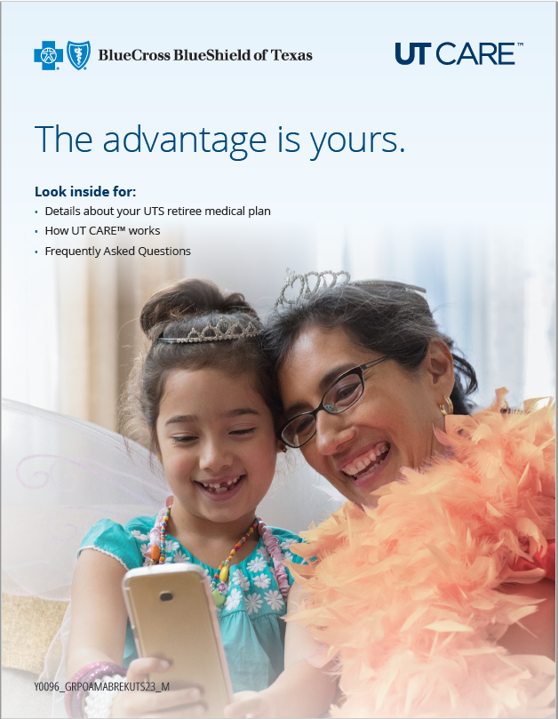
UT CARE™ Medicare PPO Enrollment Kit
You should have already received the Enrollment Kit which includes:
Letter of Welcome | Welcome to UT CARE letter with guidance for enrollment and important contact information
Enrollment Brochure | Guidance about the plan, how the benefits work and what happens after enrollment
Summary of Benefits | A detailed summary of the plan/coverage, such as the benefits, cost-sharing provisions, limitations and exceptions
Benefit Highlights | Snapshot that draws attention to benefits offered under the plan
ND Multi Language Insert | Informs on the availability of assistance services in non-English languages
Star Ratings Flyer | Information about plan performance across CMS evaluation criteria

Slide 22
Important Reminders
You need to be enrolled in both Part A and Part B of Medicare to enroll in the UT CARE™ Medicare PPO plan.
You must continue to make your Part B premium payments.
You will be automatically enrolled in the UT CARE™ Medicare PPO plan. There is no action required on your part unless Medicare needs additional information to enroll you. If necessary, you will receive a Request for Information letter from UT CARE™.
If you did want to be enrolled in this plan, you must opt-out between November 1 - November 15, 2022. The Opt Out period ended as of 11/15/2022.
Opting-out of the UT CARE™ Medicare PPO plan means you will not have any UT medical, prescription or basic life insurance coverage.
Your coverage will begin on January 1, 2023.

Slide 23
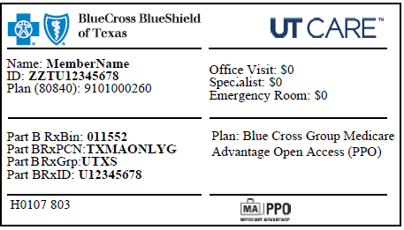
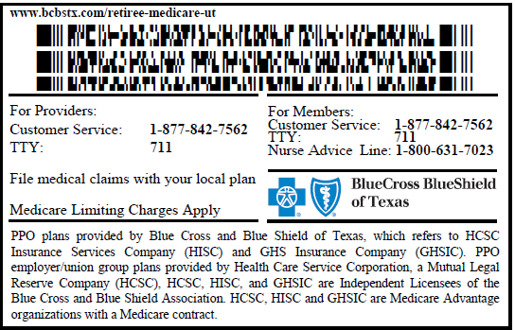

Member ID Card
You can present your UT CARE™ member ID card whenever you receive a medical service or benefit covered by your plan.
Sample
Front of ID Card
Back of ID Card

Slide 24

Learn More About UT CARE
Other resources provided by UT CARE™ and BCBSTX
Dedicated UT CARE Website
www.bcbstx.com/retiree-medicare-ut
Frequently Asked Questions https://www.bcbstx.com/retiree-medicare-ut/faqs
Customer Service
1-877-842-7562 / TTY 711 with questions

Slide 25
Questions

